Slide 1
CARGURUS.COM
Selenium automation TESTing PRESENTATION

Slide 2


Slide 3
INTRODUCTION
In this Project we are performing end-to-end quality assurance automation task using various Functional and Selenium Web driver testing tools.
This Presentation describes testing framework and tools worked with. Software testing is a critical element of software quality assurance and
represents the ultimate review of specification, design, and coding. Test Automation is the best way to increase the effectiveness, efficiency
and coverage of our software testing. Test objectives are to provide adequate coverage metrics and requirements validation to verify that the functionality of CARGURUS works as expected.

Slide 4
OVERVIEW OF THE CarGurus
CarGurus is a global, online automotive marketplace connecting buyers and sellers of new and used cars and third party administration.
Using proprietary technology, search algorithms, and innovative data analytics, CarGurus provides unbiased insights on car pricing, dealer reputation, and vehicle history.
For used vehicles calculates a fair retail price based on a detailed analysis of comparable current and previous car listings in a given market

Slide 5
Data exchange system:
CarGurus
Dealers
Consumers
Employees
Third Party Administration
Private Sellers

Slide 6
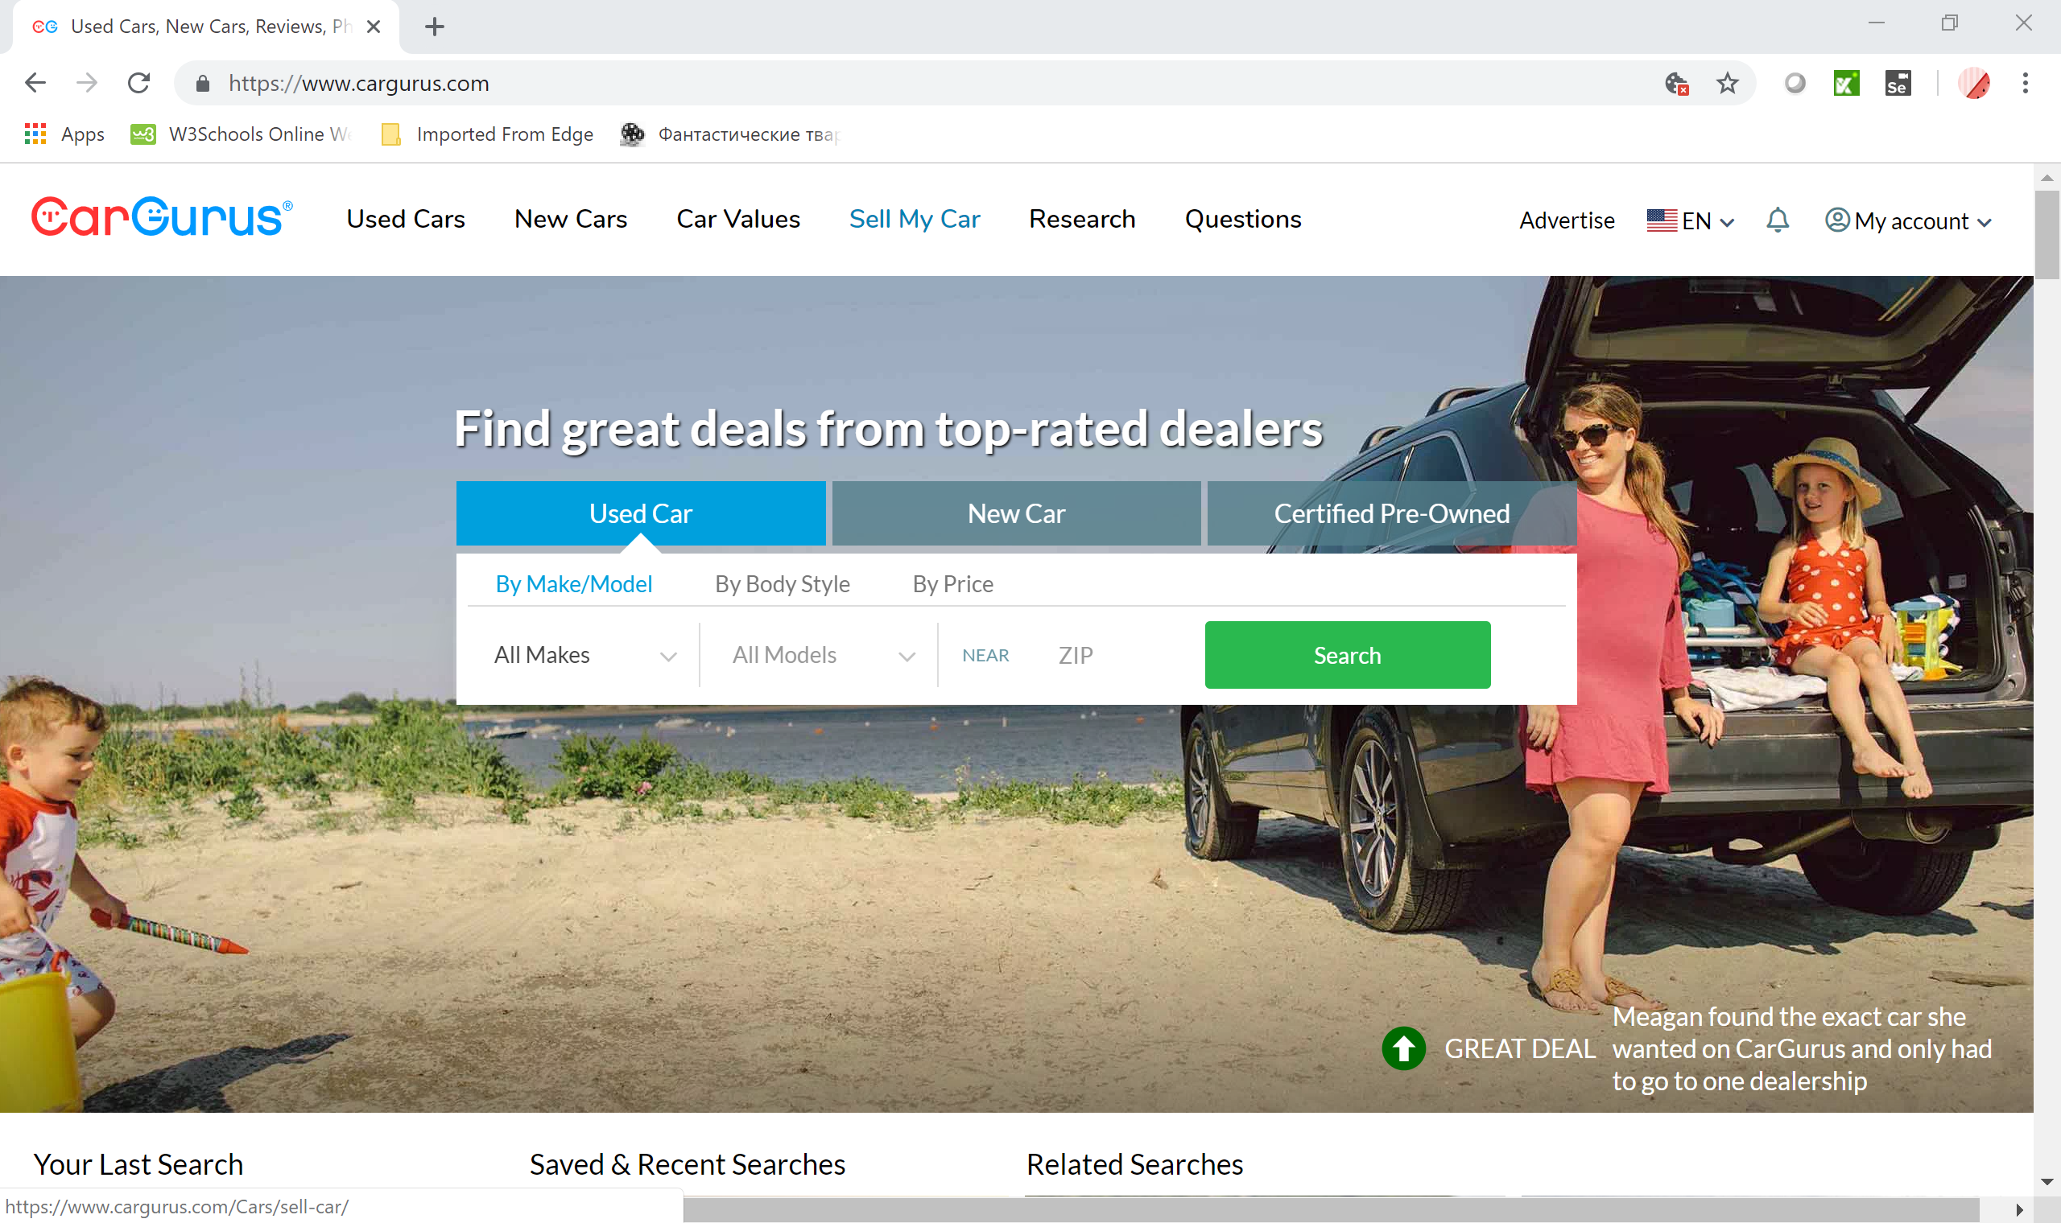
Website interface
Website has a home page with select boxes for used cars, new cars and certified Pre-owned.
This page has the option for login and password for registered users. For new customers has clickable link and helpline in order to create a new account or sign up using existing Facebook or google account.

Slide 7
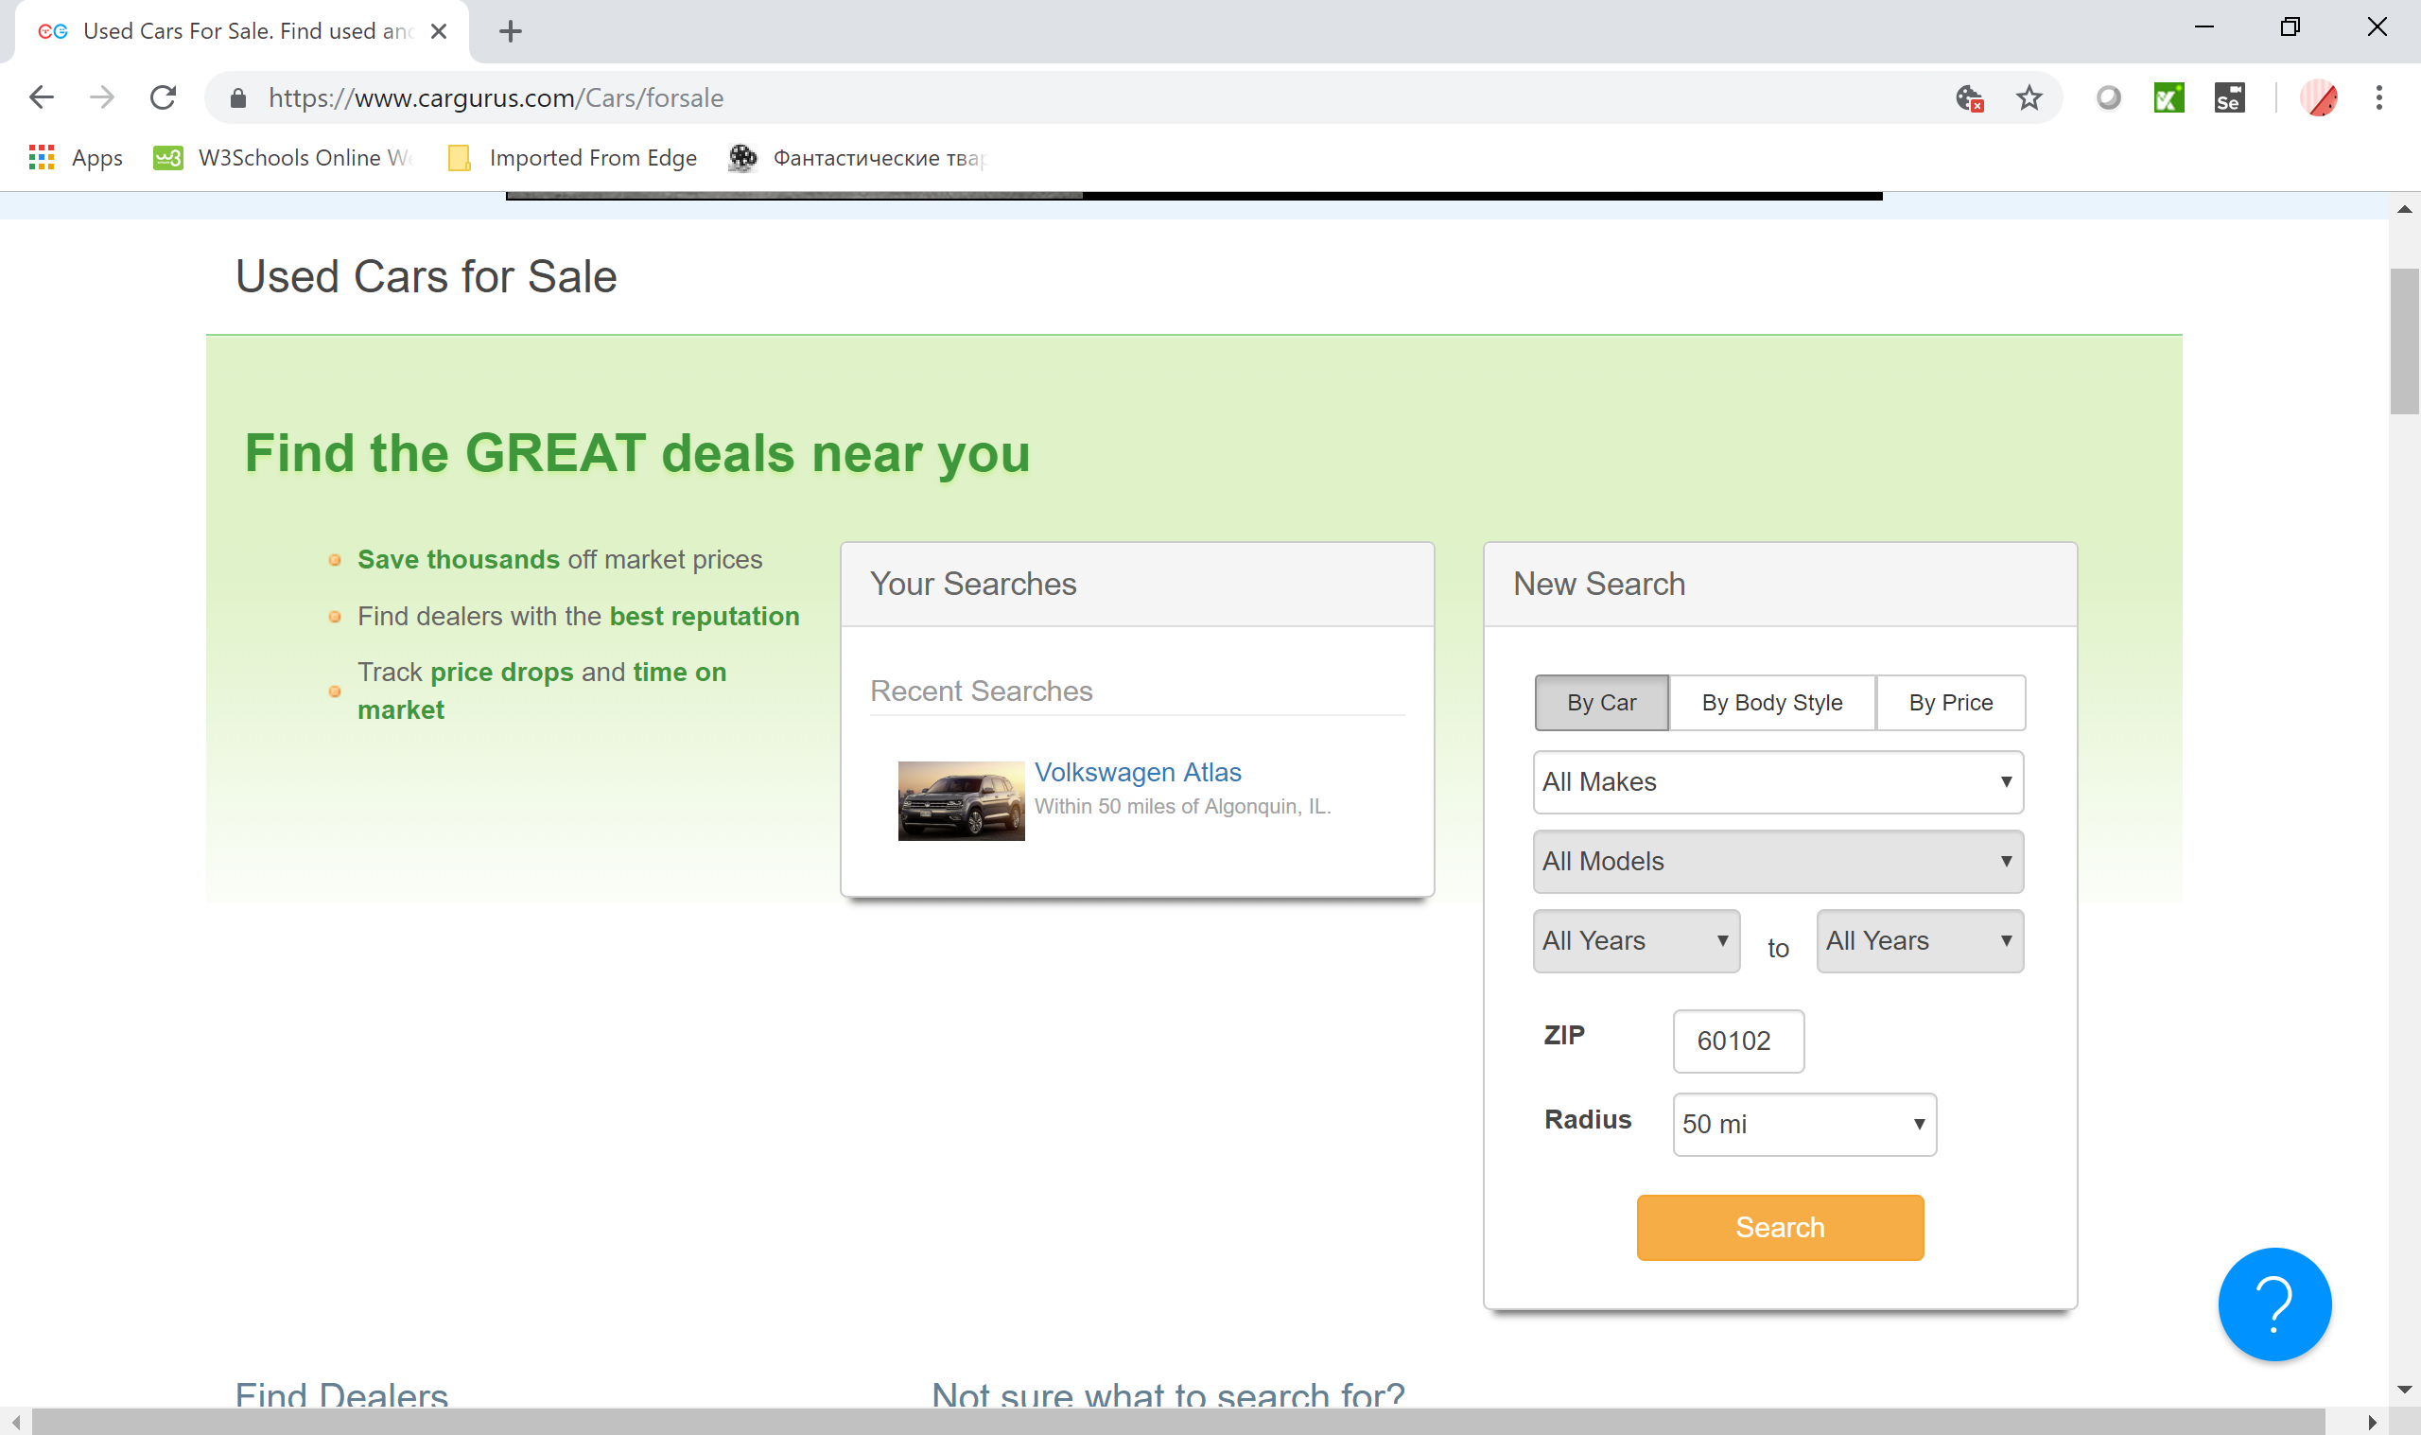
USED CARS FOR SALE SEARCH ENGINE

Slide 8
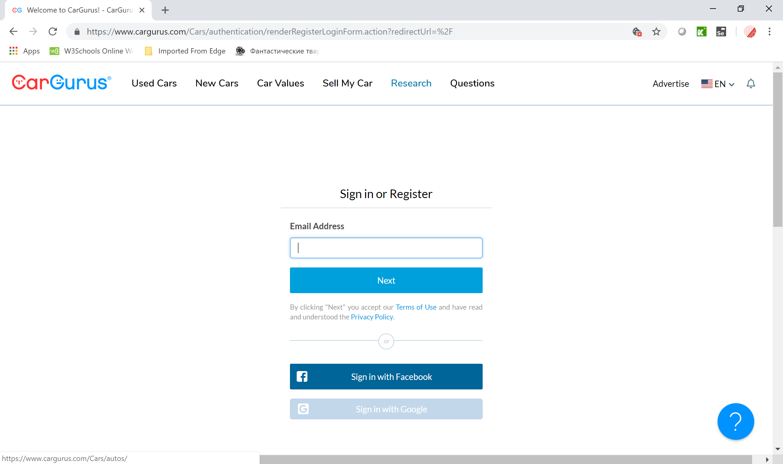
SIGN IN OR REGISTER PAGE

Slide 9
SELENIUM
Selenium automates browsers. It is for automating web applications for testing purposes.
Selenium WebDriver
creates robust, browser-based regression automation suites and tests scale and distribute scripts across many environments
Selenium IDE - which has a user Interface to record and play an activity without knowing any programming or scripting language create quick bug reproduction scripts create scripts to aid in automation-aided exploratory testing.

Slide 10
TEST PLAN

Slide 11
Test plan task list
Planning Software Test Automation
Design test automation strategies
Evaluate & prepare test Automation tools
Develop & implement Test automation solutions
Deploy test automation solutions
Review test automation solutions

Slide 12
During the Automation Testing process the following application functions will be tested:
Successfully login to the website account page.
Switching client language.
Search for used cars
Search for new cars
Search for pre-certified cars
Different types of the decision making tools like car values, questions, car values. ??????

Slide 13
METHODS, APPROACHING TO VALIDATE THE DATA
Approach:
Manual and Automation testing will be performed.
Test Methods:
Black Box
White Box
Static Testing
Dynamic Testing

Slide 14
Website Modules:
Clickable search engine boxes for used, new pre certified cars.
There are ‘news section’….

Slide 15
The stakeholders
Dealers;
Private Sellers;
Customers;
Employees;
Third Party;
Owners;

Slide 16
Test plan
To do test possible and positive ☺
Drink coffee
Relax
Exercise
Be calm
Don’t worry

Slide 17
Test plan task list
Planning Software Test Automation
Design test automation strategies
Evaluate & prepare test Automation tools
Develop & implement Test automation solutions
Deploy test automation solutions
Review test automation solutions

Slide 18
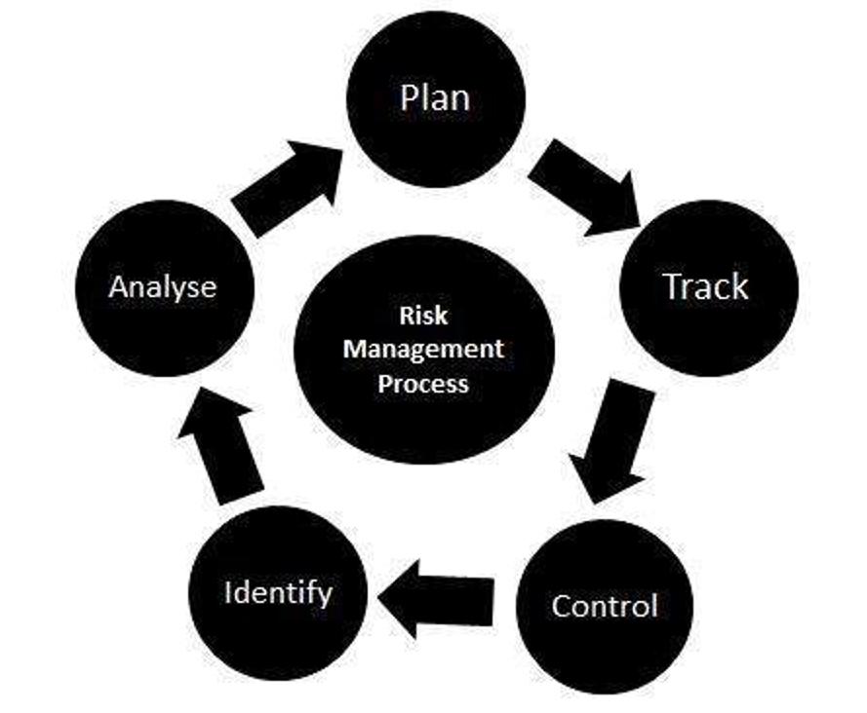
RISKS
Integrity level is 1 (negligible)
According to IEEE829 mitigation in this level of integrity is not required but for this project is going to be used since it’s the first project for this team. Risk – Wrong time estimation to complete testing or the whole project.
Mitigation plan – Establish the scope before beginning the testing tasks and pay attention in the project planning and also track the time estimates constantly.
Risk – Improper training or lack of knowledge of team members.
Mitigation plan – Team lead or manager has to make sure that a team member has required knowledge to complete the task before assigning it. If the task can not be assigned to a different team member make sure that this team member gets proper training from the rest of the team, manager or from ITExperts staff.
Risk – Product is too complex to test.
Mitigation plan – Carefully prepare a test plan. Develop and execute manual testing first. If during designing, developing or executing automation 30% of test can be implemented then the scope of the test plan may be changed

Slide 19
The table sets of hardware and software resources for the testing Website:
OS WINDOWS
BROWSER
GOOGLE CHROME,
Firefox;

Slide 20
Roles and responsibilities
Role | Minimum Resources Recommended (number of workers allocated full-time) | Responsibilities/Comments
QA Lead | 1 | Prepare Test Plan
QA Manager | 1 | Provides management oversight Responsibilities: Provide technical direction Acquire appropriate resources Management reporting
QA Engineer | 4 | Execute testing process Responsibilities: Write Test Cases Execute Test Cases manually Execute Test Cases using automation tools Write Bug Reports

Slide 21
Test plan time line milestone
Task | Volume of work | Starting Date | Expiration Date
Test Plan Creation | 1 days | 01.16.2019 | 01.16.2019
SetUp Enviroment | 1 days | 01.16.2019 | 01.16.2019
Writing Test Cases | 1 days | 01.16.2019 | 01.16.2019
Automation test Execution | 1 days | 01.16.2019 | 01.16.2019
Analysis of Testing | 1 days | 01.16.2019 | 01.16.2019
Presentation Date |  |  | 01.16.2019

Slide 22
Automation testing process
The following functions will be tested:
Interface page clickable boxes [used, new, pre….]

Slide 23
Types of testing
Functional Testing is defined as a type of testing which verifies that each function of the software application operates in conformance with the requirement specification. This testing mainly involves black box testing and it is not concerned about the source code of the application.
Regression Testing is defined as a type of software testing to confirm that a recent program or code change has not adversely affected existing features. Is nothing but a full or partial selection of already executed test cases which are re-executed to ensure existing functionalities work fine.

Slide 24
Methods, approaching validate the data
The identification of functions that the software is expected to perform
The creation of input data based on the function's specifications
The determination of output based on the function's specifications
The execution of the test case
The comparison of actual and expected outputs
To check whether the application works as per the customer need

Slide 25
TECHNOLOGIES WERE USED:
JAVA
JUNIT
MAVEN
SELENIUM WEBDRIVER
KATALON IDE
JENKINS
SELENIUM GRID
NETBEANS
GIT
GITHUB
DATA DRIVEN TESTING

Slide 26
Test data
Automated testing is a process to validate that software functions appropriately and meets requirements before it is released into production. Automated testing tools execute tests, report outcomes and compare results with earlier test runs.
Principles of Software Testing:
Exhaustive testing is impossible
Testing is context dependant
Absence of error
Pesticide paradox

Slide 27

Dependency management
Build lifecycle management
Large existing repository
Build process is standardized for all projects
Easy to plugin to CI, You can run the same build locally and via a ci tool like Jenkins by setting up a maven build job

Slide 28

JUnit is an open source framework designed for the purpose of writing and running tests. Junit Provides:
Annotations to identify test methods assertions for testing expected results test runners for running test
Allows you to writes code fasten
Increases QUALITY
Simple
Less time
Tests can be run automatically
Test suites
Test progress

Slide 29

Selenium webdriver
Selenium-WebDriver makes direct calls to the browser using each browser’s native support for automation. How these direct calls are made, and the features they support depends on the browser you are using.

Slide 30

Katalon ide
Katalon Recorder helps record, play, debug, manage automated tests, and export to C#, Java, Ruby, Python, Groovy, or Robot Framework

Slide 31

Jenkins is an open source automation server written in Java. Jenkins helps to automate the non-human part of the software development process, with continuous integration and facilitating technical aspects of continuous delivery.

Slide 32


NetBeans is an integrated development environment (IDE) for Java. NetBeans allows applications to be developed from a set of modular software components called modules

Slide 33
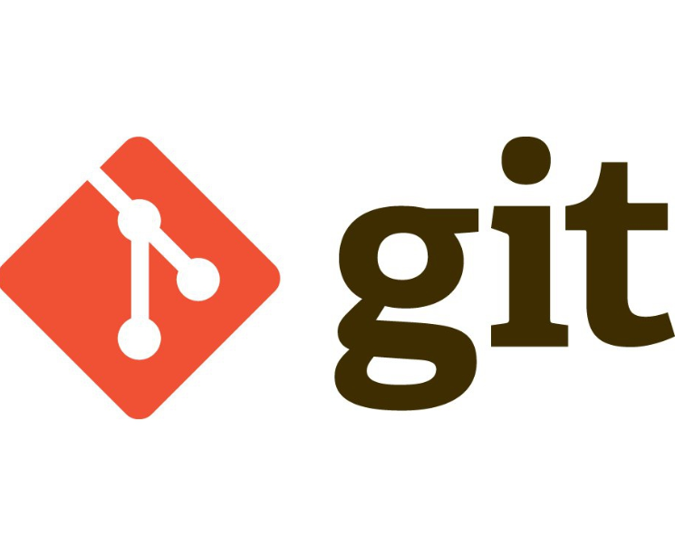
Git is a free and open source distributed version control system designed to handle everything from small to very large projects with speed and efficiency.

Slide 34

GitHub is a web-based version-control and collaboration platform for software developers. Git is used to store the source code for a project and track the complete history of all changes to that code. It allows developers to collaborate on a project more effectively by providing tools for managing possibly conflicting changes from multiple developers.

Slide 35
Data driver testing
Data-driven testing (DDT) is a software testing methodology that is used in the testing of computer software to describe testing done using a table of conditions directly as test inputs and verifiable outputs as well as the process where test environment settings and control are not hard-coded. In the simplest form the tester supplies the inputs from a row in the table and expects the outputs which occur in the same row.

Slide 36
CONCLUSION
CHALLENGES

Slide 37
The project was created and presented by the group of ITEXPS students:
1
2
3
4 JURGITA NARVILIENE
With the support, professional help and guidance by
Narendra Lilaramani & Tushar Patel © ITEXPS_Students, 2019

